Slide 1

Postman: The API Development and Testing Platform
Manage and Test Your APIs with Ease
Eda TERZİOĞLUDoğa SAÇIKARA

Slide 2
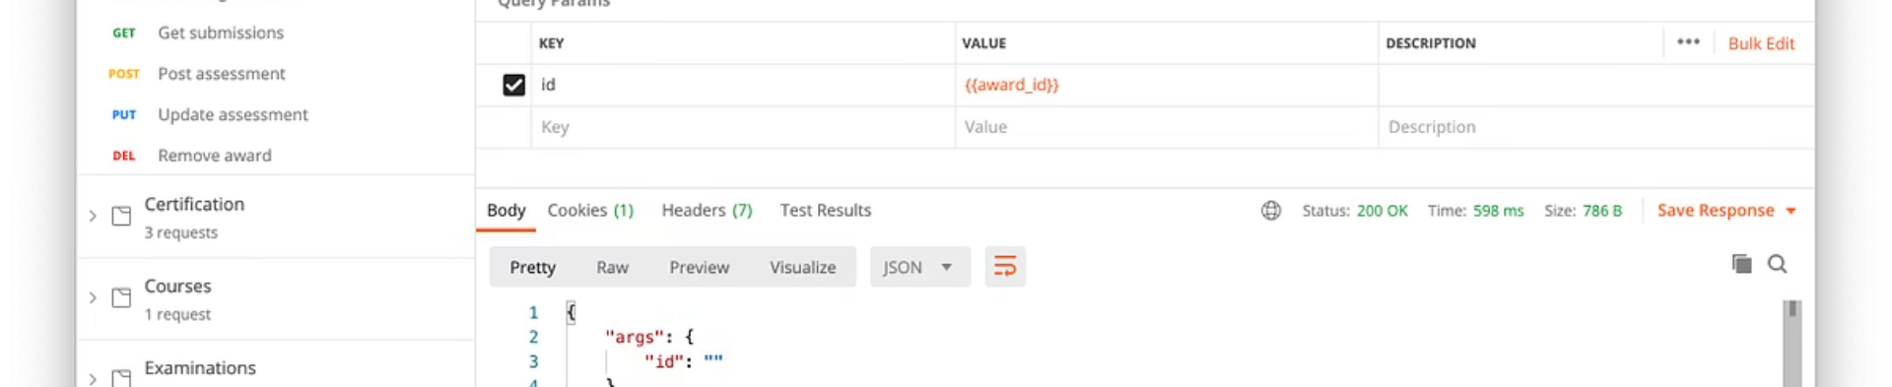
What is Postman?
API Platform
User-Friendly
Versatile
Develop, test, document, and manage APIs
Create, send, analyze API requests efficiently
Suitable for individuals and teams

Slide 3

The Journey of Postman
2012
2016-2018
Chrome extension by Abhinav Asthana
Team collaboration and cloud workspaces
1
2
3
4
2014
2020+
Standalone desktop application
Comprehensive API lifecycle platform

Slide 4







Postman's Core Features
User-Friendly Interface
Multiple Request Types
Environment Variables
Easy to use, even with limited tech knowledge
GET, POST, PUT, DELETE, GraphQL, WebSocket
Dynamic configuration for different environments
Team Collaboration
Test Automation
Documentation
Real-time sharing via workspaces
JavaScript-based scripts for automated testing
Automatic generation of API documantation

Slide 5
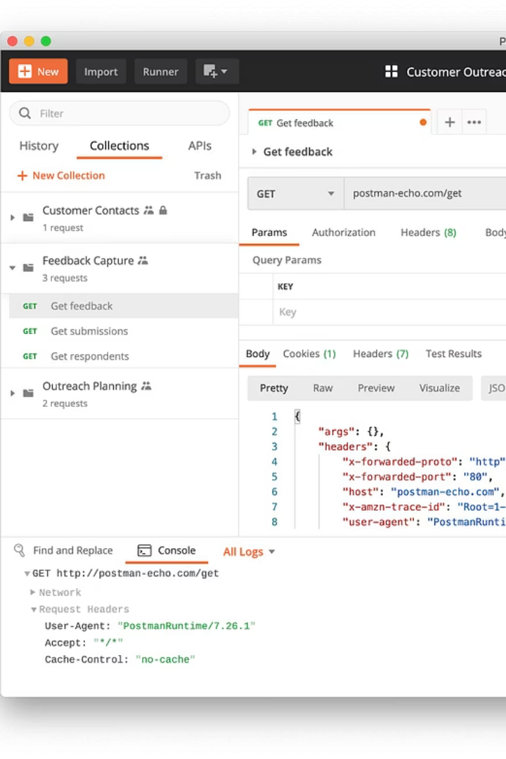




Beyond the Basics with Postman
Collections
Organize and share related API requests
Mock Server
Simulate API responses without a real backend
API Monitoring
Track performance with automated tests
Newman
Run tests via command line for CI/CD integration

Slide 6












Where is Postman Used?
API Development
Software Testing
Test endpoints and debug issues
Automated validation for QA teams
Integration Testing
Education
Verify data flow between systems
Learn and practice API concepts
Documentation
Prototyping
Create and share API guides
Rapidly test API designs

Slide 7

Postman's Advantages
Free Tier
Sufficient for basic needs
Cross-Platform
Windows, macOS, Linux, web browsers
Quick Learning Curve
Simple interface for fast adoption
Strong Community
Extensive documentation and forums
Integrations
Works with GitHub, Slack, Jenkins and more

Slide 8



Postman's Limitations
Paid Features
Advanced features require subscription
Performance
May slow with large collections
Dependency Risk
Teams may overlook alternative tools

Slide 9








Why is Postman Important?
Growing Relevance
As API usage grows, so does Postman's importance
Streamlined Processes
Simplifies API development and testing
API Foundation
APIs are the backbone of modern software
To Serve
Serve developers, QA teams and product managers alike

Slide 10

Let's See Postman in Action!
DEMO
Simple API test using Postman

Slide 11
Thank you!

